Slide 1
Data Cleaning and EDA

Slide 2
Data Cleaning
"None" changed to 0 to preserve data type
Rounded down number of bathrooms
Removed any entries with sqrt_ft=0

Slide 3
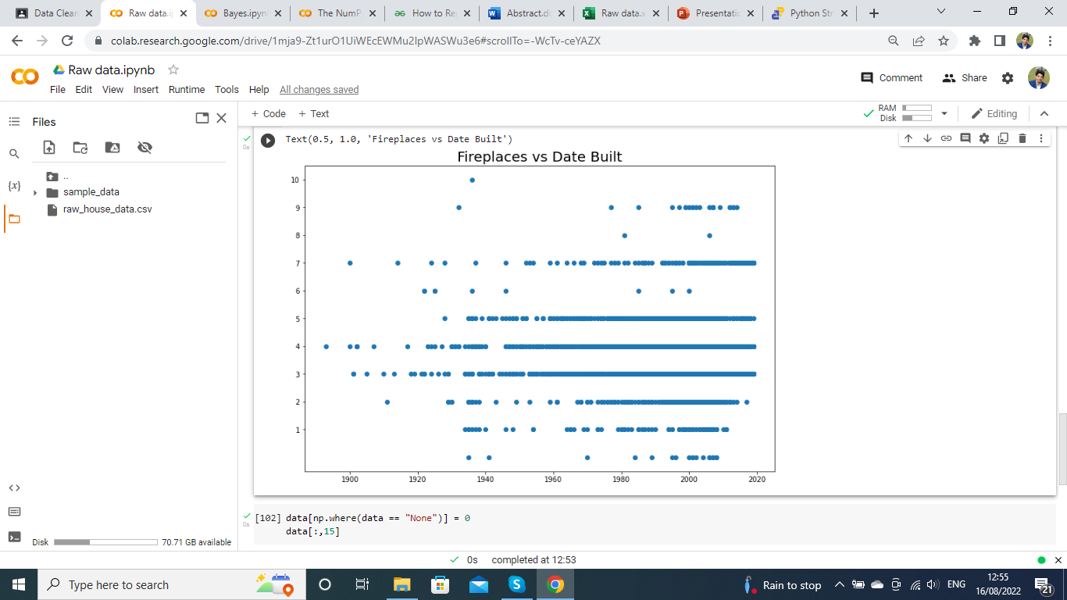

Slide 4
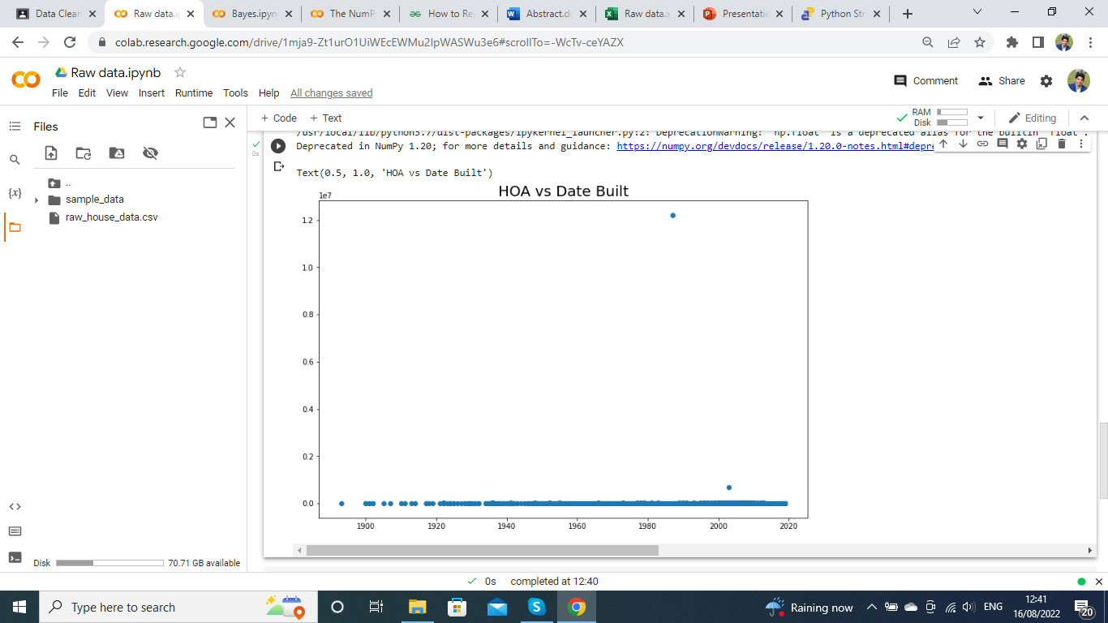

Slide 5
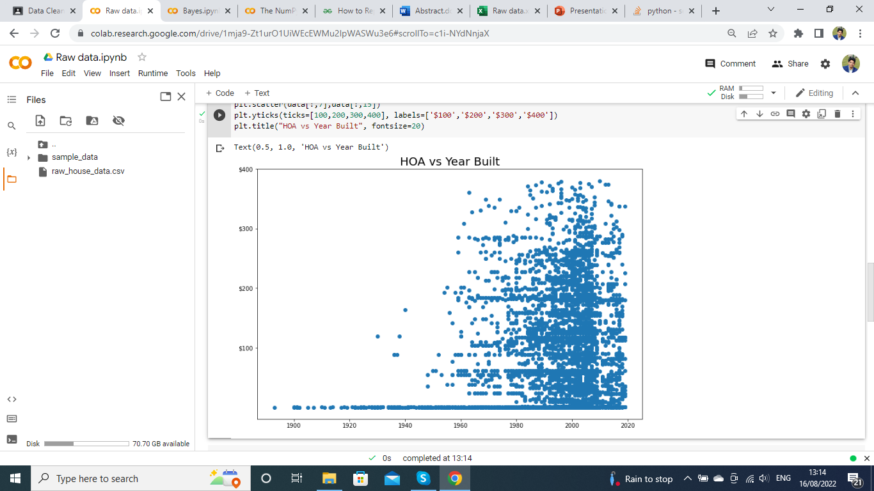

Slide 6
